Slide 1
Motion with Constant Acceleration
the 4 KINEMATIC Equations

Slide 2
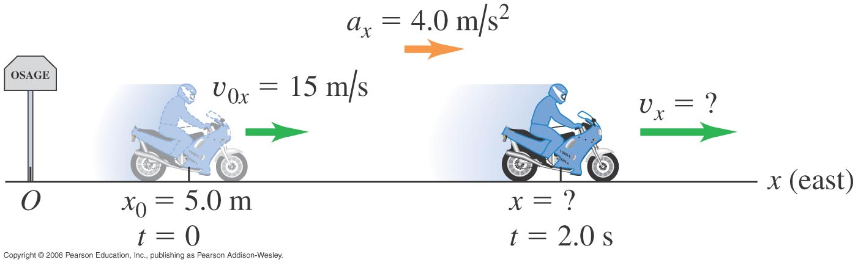
Motion with Constant Acceleration: Bike Rider
A motorcyclist heading east through a city accelerates after he passes the signpost marking the city limits. His acceleration is constant 4.0 m/s². At time t = 0 he is 5.0 m east of the signpost, moving east at 15 m/s. a) Find his position and velocity at time t = 2.0 s. b) Where is the motorcyclist when his velocity is 25 m/s?

Slide 3
Motion with Constant Acceleration: Bike Rider
x = 43 m; v_{x} = 23 m/s
When v_{x} is 25m/s, x = 55 m.

Slide 4
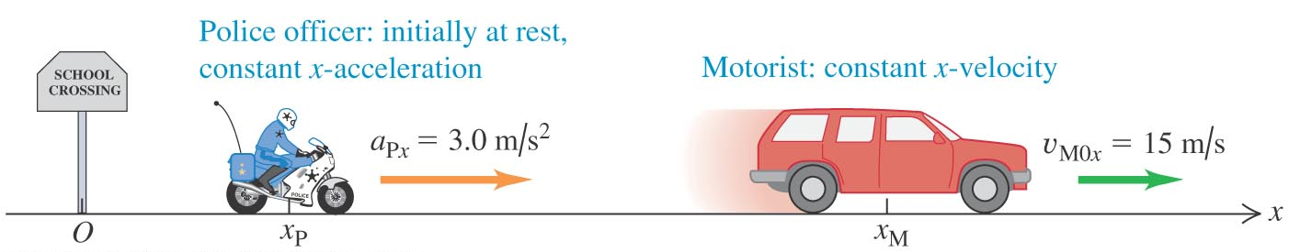
Motion with Constant Acceleration: Hot Pursuit
A motorist traveling with constant velocity of 15 m/s passes a school-crossing corner, where the speed limit is 10 m/s. Just as the motorist passes, a police officer on a motorcycle stopped at the corner starts off in pursuit with constant acceleration of 3.0 m/s². a) How much time elapses before the officer catches up with the motorist? b) What is the officer’s speed at that point? c) What is the total distance each vehicle has traveled at that point?

Slide 5
Motion with Constant Acceleration: Hot Pursuit
t = 10 s
v_{officer} = 30 m/s
x_{officer} = x_{motorist} = 150 m

Slide 6
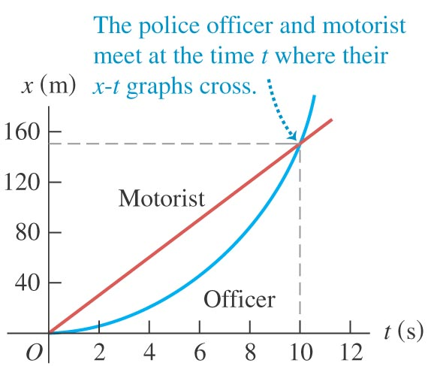
Motion with Constant Acceleration: Hot Pursuit

Slide 7
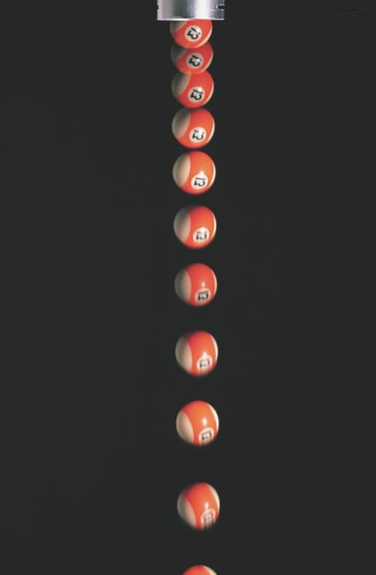
Freely – Falling Bodies
a common example of motion with constant acceleration
Free fall
– an idealized motion
(i.e. neglecting the effects of air resistance, the rotation of the earth, and the decrease of acceleration with increasing altitude)
acceleration g = 9.8 m/s², downward

Slide 8
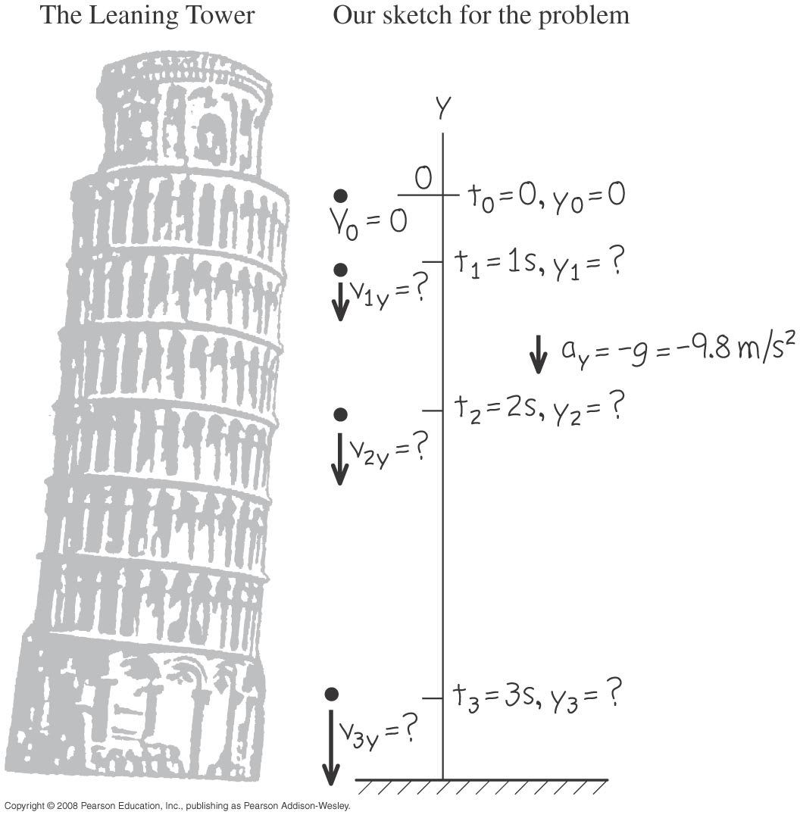
Freely – Falling Bodies: Copying Galileo
A coin is dropped from the Leaning Tower of Pisa. It starts from rest and falls freely. Compute its position and velocity after 1.0, 2.0, and 3.0 s.

Slide 9
Freely – Falling Bodies: A Giveaway Ball
You throw a ball vertically upward from the roof of a tall building. The ball leaves your hand at a point even with the roof railing with an upward speed of 15.0 m/s; the ball is then in free fall. On its way back down, it just misses the railing. At the location of the building, g = 9.8 m/s². Find
the position and velocity of the ball 1.00 s and 4.00 s after leaving your hand;
the velocity when the ball is 5.00 m above the railing;
the maximum height reached and the time at which it is reached; and
the acceleration of the ball when it is at its maximum height.

Slide 10
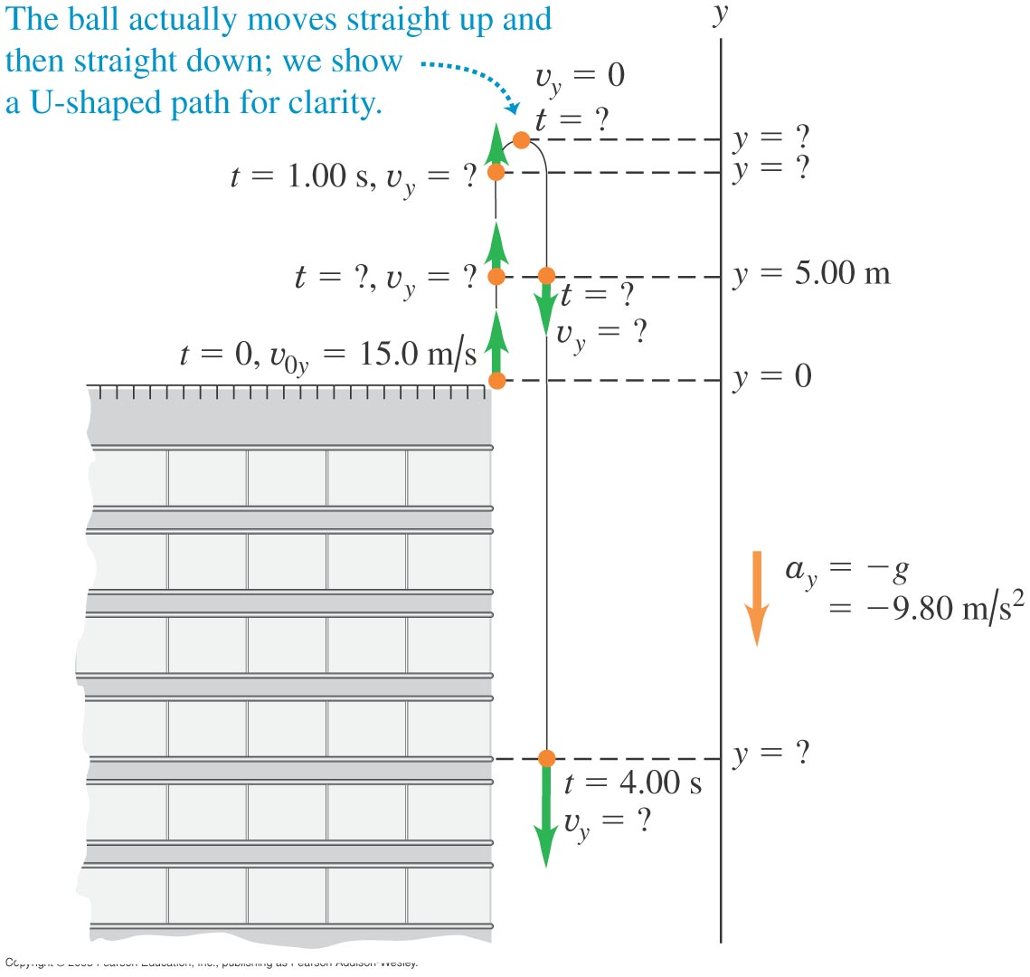

Slide 11
Freely – Falling Bodies: A Giveaway Ball
y_{(t = 1.00 s)} = 10.1 m v_{y(t = 1.00 s)} = 5.2 m/s
y_{(t = 4.00 s)} = –18.4 m v_{y(t = 4.00 s)} = –24.2 m/s
b) v_{y(y} ₌ _{5m)} = ± 11.3 m/s
c) y_{max} = 11.5 m t (at y_{max}) = 1.53 s
d) a_{y} (at y_{max}) = – 9.8 m/s² (acceleration is constant)

Slide 12
End-of-Chapter Skills Check
  To describe straight-line motion in terms of velocity and acceleration
  To distinguish between average and instantaneous velocity and average and instantaneous acceleration
  To interpret graphs of position versus time and velocity versus time for straight-line motion
  To understand straight-line motion with constant acceleration
  To examine freely falling bodies

